Slide 1
Baltimore 911 Calls Data Analysis
Insights for Resource Allocation and Crime Advisory
Presented By:- Parth Patel

Slide 2
Data Summary of 911 Calls
Total Incidents: analyzed over 292,000 calls related to 911 public safety in Baltimore.
Crime Types: There are 14 different types of crimes recorded, including Larceny, Assault, and Burglary.
Geographic Data: Each call is tagged with location information (latitude and longitude) to pinpoint where the crimes occurred.
Dates: The data covers incidents from 2014 to 2020.
Note on Data Gaps: Some details, like the weapon used, were not available for all calls.

Slide 3
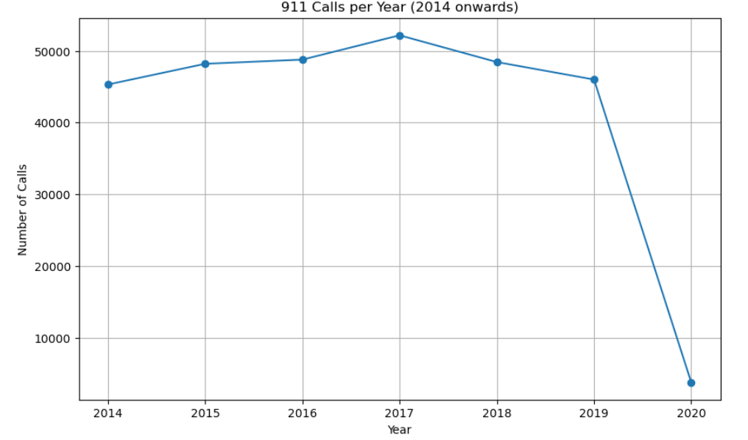
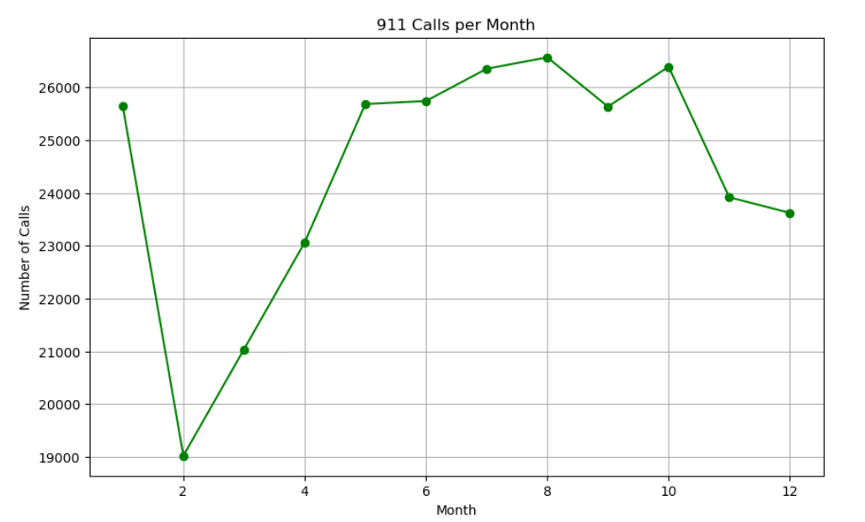
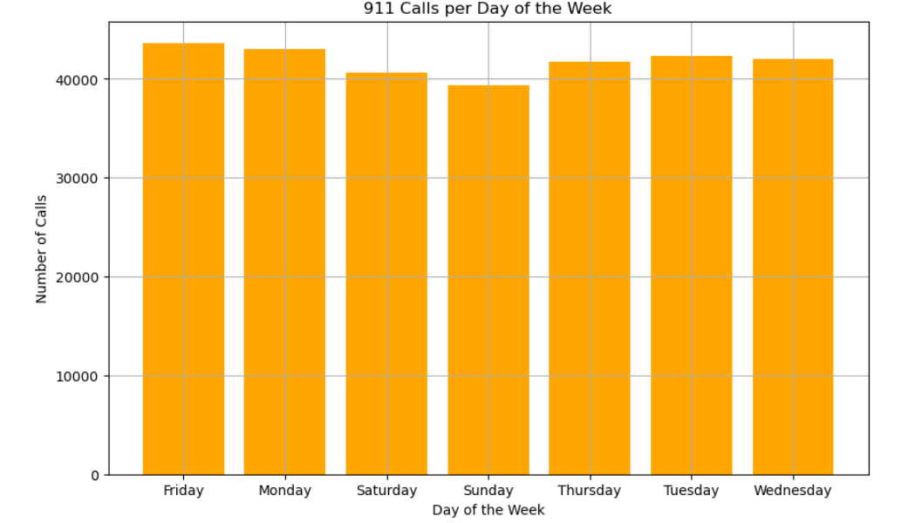
Crime Trends Over Time
Crime volume fluctuated from 2014-2020, with peaks in 2015 and 2016.
Higher crime rates during summer months (June-August), with a drop in winter.
Friday and Saturday have the highest crime rates.
Resource allocation should focus on weekends and summer months for better crime prevention.

Slide 4
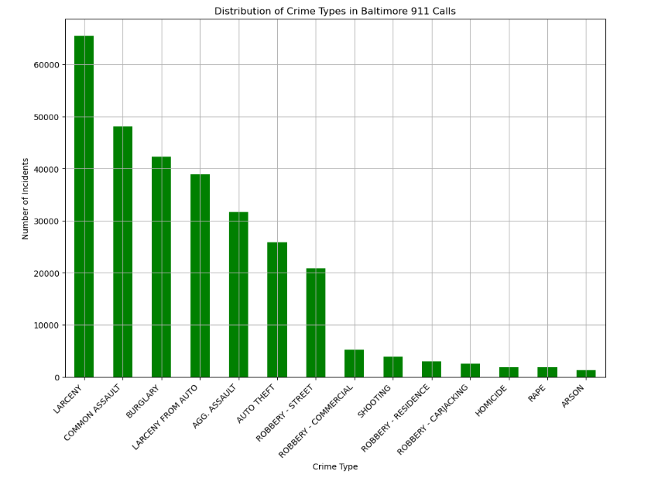
Distribution of Crime Types
Top Crime Types:
Larceny: 65,508 incidents (most frequent)
Common Assault: 48,061 incidents
Burglary: 42,237 incidents
Larceny and Assault dominate, suggesting these crime types should be the focus for intervention.

Slide 5
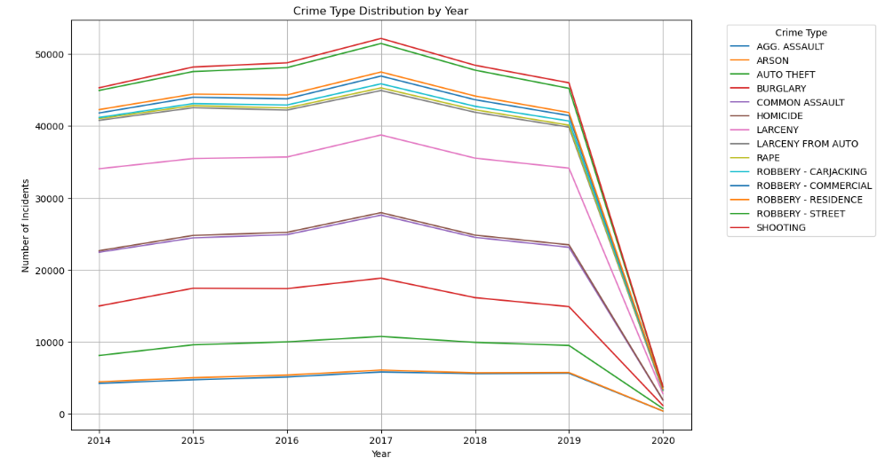
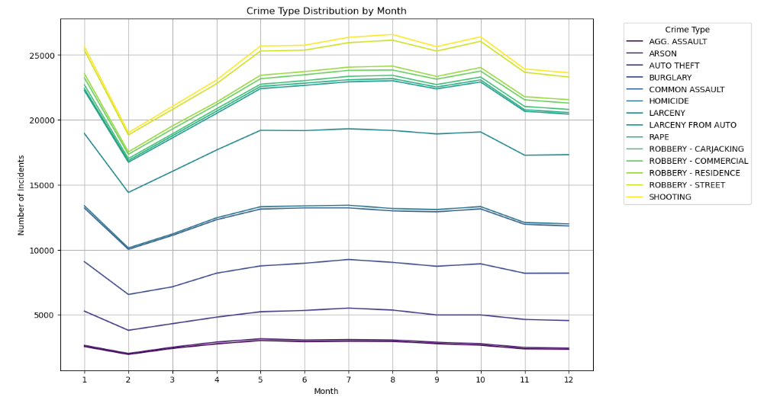
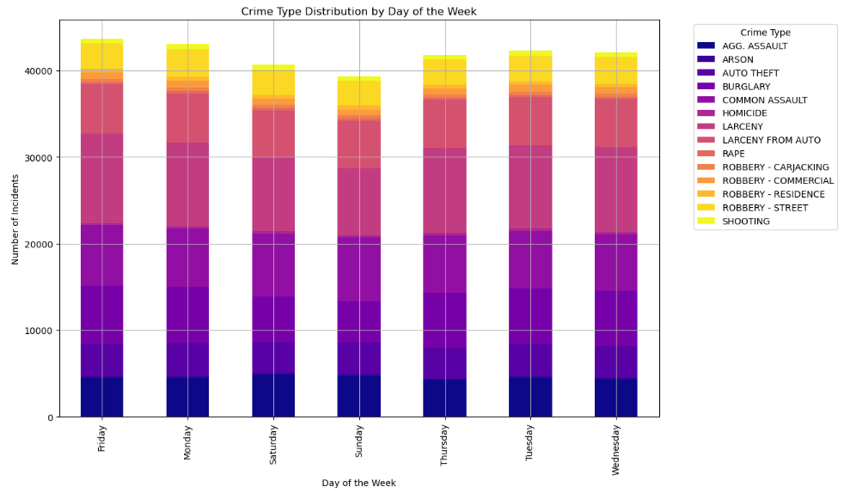
Crime Type Variation Over Time
Larceny has steadily increased, while Assault fluctuated.
Peaks in Larceny and Assault during summer months.
Larceny and Assault occur most frequently on Fridays and Saturdays.
Crime prevention strategies should target specific crime types during high-risk periods

Slide 6
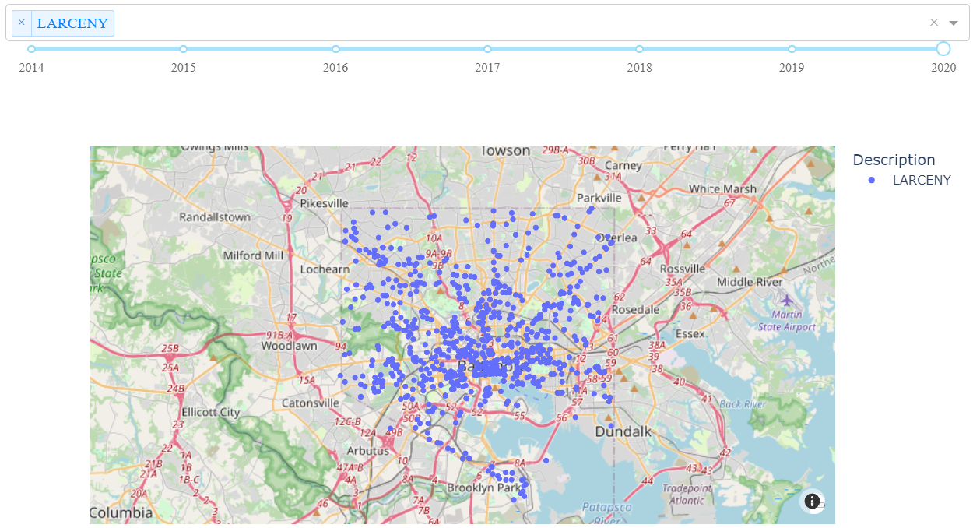
Crime Hotspots in Baltimore
Note: The full interactive dashboard allows users to filter crime by type, year, and location, providing real-time insights for resource allocation.

Slide 7
Interactive Crime Map
The interactive map displays the location of crimes in Baltimore using geographic coordinates.
Each point on the map represents a crime incident, and users can filter by year or crime type to see how crime patterns change over time.
Areas with a high density of crimes (hotspots) are clearly visible on the map, with certain neighborhoods experiencing more frequent incidents.
Downtown Baltimore shows a significant cluster of Larceny incidents, while other neighborhoods have more diverse crime types.
Law enforcement can use the map to focus on crime hotspots, deploying more resources to areas that show high crime frequency.
The ability to filter by year and crime type helps in identifying which areas need more attention at specific times.

Slide 8
Key Findings and Recommendations
Findings:
Crime spikes in summer and weekends, with Larceny being the most frequent crime.
Specific high-crime areas and periods can be targeted for better resource allocation.
Recommendations:
Use the interactive dashboard for continuous crime pattern monitoring.
Focus patrols during high-risk times (summer, weekends).
Call to Action: Implement findings and dashboard into police resource planning.

Slide 9
Thank You

